Slide 1
Terraform destory
Ow

Slide 2
List the objects
terraform state list
data.aws_ami.latest_amazon_linux
aws_instance.example
aws_key_pair.example
aws_subnet.example_subnet
aws_vpc.example

Slide 3
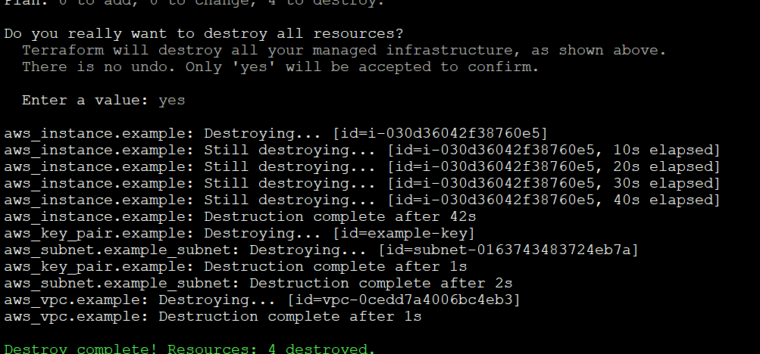
Delete all the resource
terraform destroy

Slide 4
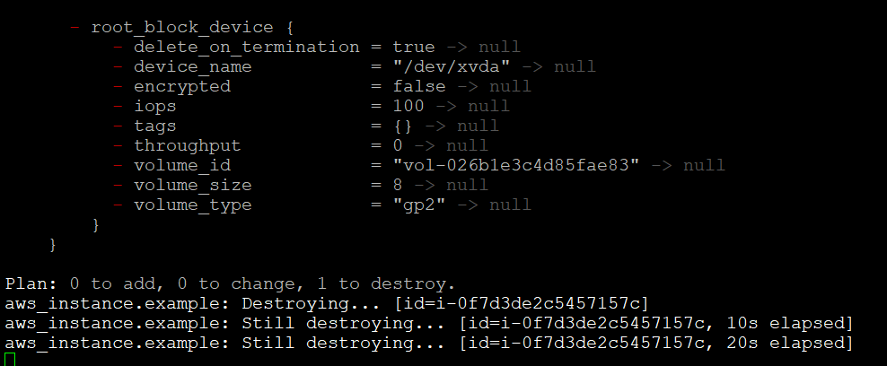
Delete a specific resource
terraform state show aws_instance.example
terraform destroy -target=aws_instance.example -auto-approve

